Slide 1
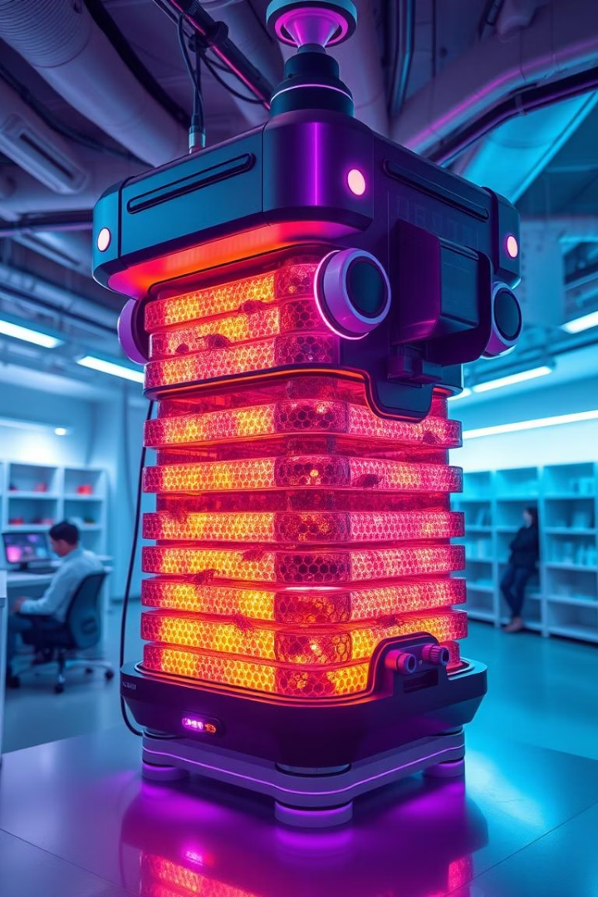

Design and Implementation of ESP32-Based IoT Devices: An Educational Framework and Project Showcase
Darko Hercog, Tone Lerher, Mitja Truntič, and Oto Težak
University of Maribor, Slovenia
by Abdullah Mian

Slide 2
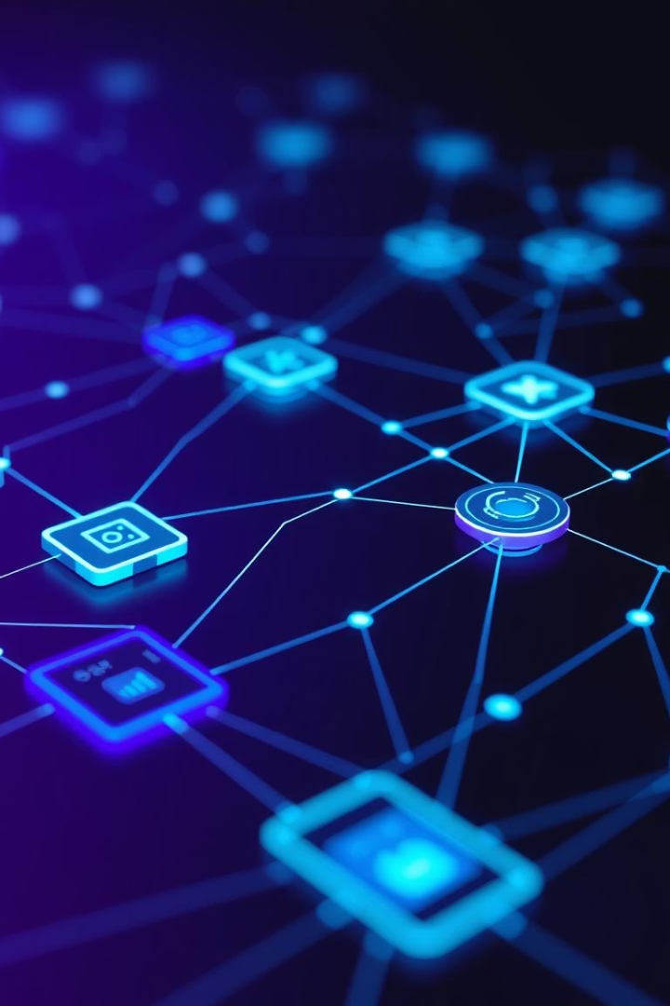
The Rise of IoT and Educational Need
IoT's Rapid Growth
14.3 billion IoT devices in 2022, with continued growth expected.
Demand for Skills
Growing need for IoT expertise in various industries.
Paper's Purpose
Presents educational IoT tools, technologies, and a course framework.
Key Hardware
Focuses on ESP32 modules like LilyGO TTGO T8.

Slide 3
Essential IoT Device Characteristics & Layers
IoT "Thing" Characteristics
IoT Device Layers
Data acquisition
Physical layer
Reaction capabilities
Network layer
Network reception
Application layer
Communication support

Slide 4





Integrating IoT into Education
Smart Environments
E-Learning & Remote Labs
RFID for Attendance
Improving school building efficiency and smart lecture rooms.
Enhancing learning experiences with interactive tools.
Automating administrative tasks in educational settings.
Project-Based Learning
Benefits for practical skill development and engagement.

Slide 5
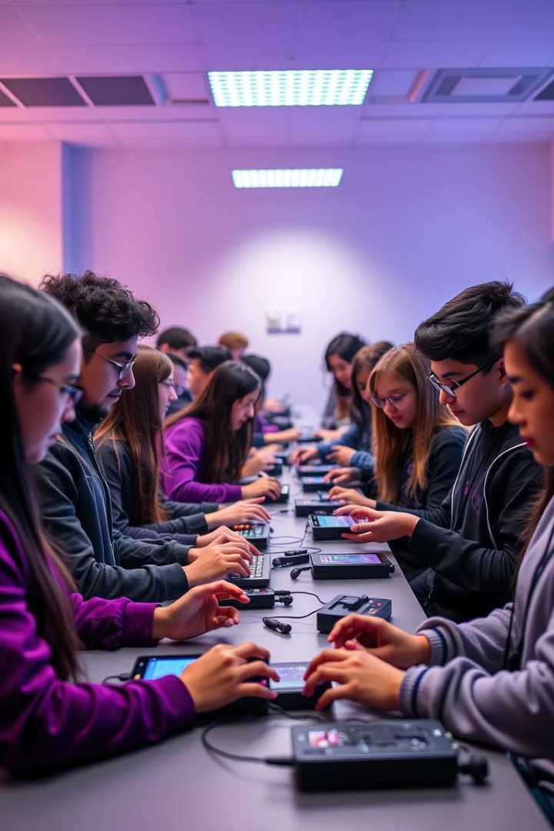
Specific Educational IoT Approaches
Gamification & Virtual Labs
Enhancing engagement and practical learning.
Support for Disabilities
IoT applications aiding students with special needs.
Project-Based Methods
Improving educational quality through hands-on projects.
Educational Platforms
Examples of specialized IoT modules and platforms for learning.

Slide 6
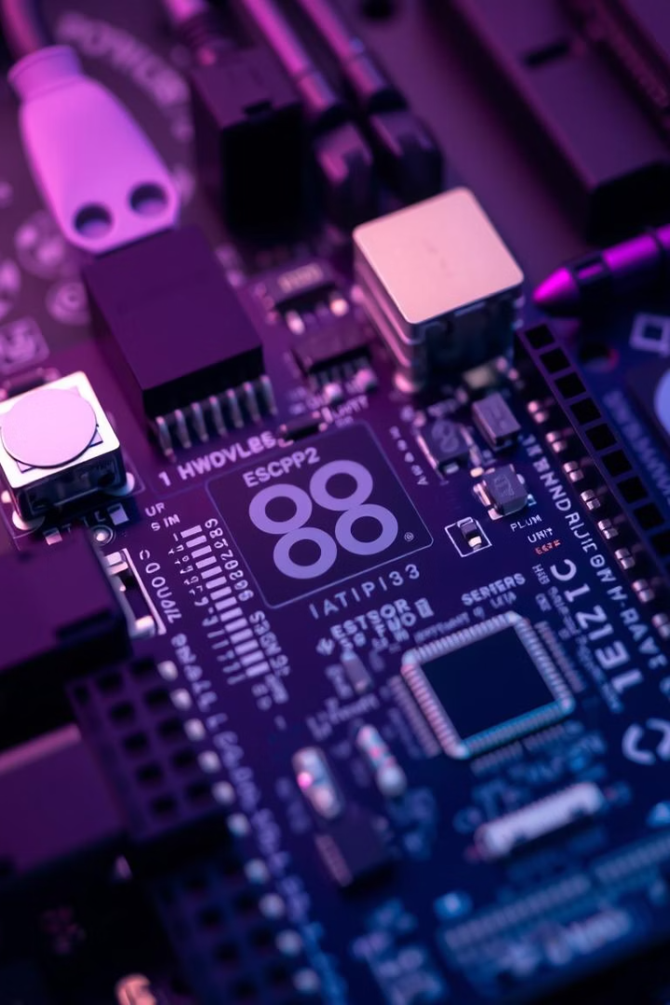



A Pedagogical Framework & Tools
Custom Hardware
ESP32 sensor extension boards simplify connections and testing.
Software Utilized
Arduino IDE with ESP32 libraries and Digilent WaveForms.
Structured Course
Introductory ESP32 course flowchart guides learning.

Slide 7
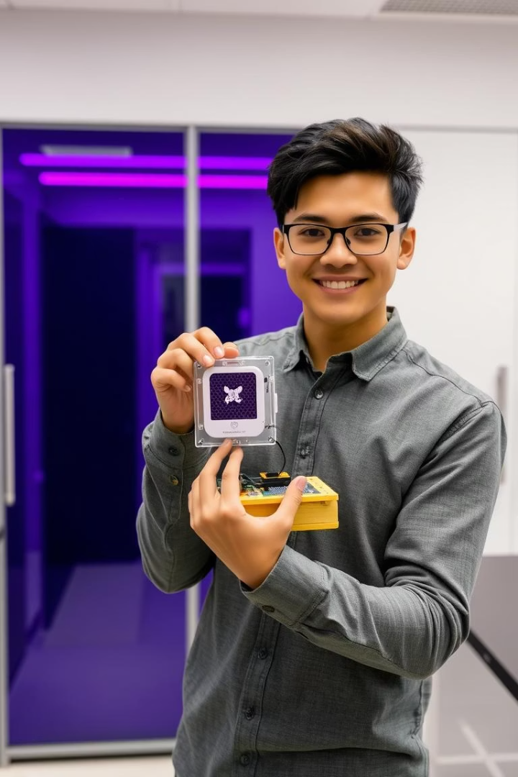
Student-Driven Project Implementation
Practical Application
Emphasis on student-developed projects for hands-on learning.
Skill Development
Students learn PCB design, programming, 3D printing, and IoT integration.
Showcase Project
The Beehive Monitoring System serves as a concrete example.

Slide 8

Educational System Overview
Project Phase
ESP32 Introduction
Idea, components, testing, PCB, enclosure, firmware, integration, prototype.
Basics, I/O, and sensor integration.
1
2
3
Data & Connectivity
Data logging, Wi-Fi, and IoT concepts.

Slide 9

Q&A
Thank you for your attention. Any questions?

